Slide 1
Chapter 21 Generics

Slide 2
Objectives
To know the benefits of generics (§21.1).
To use generic classes and interfaces (§21.2).
To declare generic classes and interfaces (§21.3).
To understand why generic types can improve reliability and readability (§21.3).
To declare and use generic methods and bounded generic types (§21.4).
To use raw types for backward compatibility (§21.5).
To know wildcard types and understand why they are necessary (§21.6).
To convert legacy code using JDK 1.5 generics (§21.7).
To understand that generic type information is erased by the compiler and all instances of a generic class share the same runtime class file (§21.8).
To know certain restrictions on generic types caused by type erasure (§21.8).
To design and implement generic matrix classes (§21.9).

Slide 3
Why Do You Get a Warning?
public class ShowUncheckedWarning {
public static void main(String[] args) {
java.util.ArrayList list =
new java.util.ArrayList();
list.add("Java Programming");
}
}
To understand the compile warning on this line, you need to learn JDK 1.6 generics.

Slide 4
Fix the Warning
public class ShowUncheckedWarning {
public static void main(String[] args) {
java.util.ArrayList<String> list =
new java.util.ArrayList<String>();
list.add("Java Programming");
}
}
`
No compile warning on this line.

Slide 5
What is Generics?
Generics is the capability to parameterize types. With this capability, you can define a class or a method with generic types that can be substituted using concrete types by the compiler. For example, you may define a generic stack class that stores the elements of a generic type. From this generic class, you may create a stack object for holding strings and a stack object for holding numbers. Here, strings and numbers are concrete types that replace the generic type.

Slide 6
Why Generics?
The key benefit of generics is to enable errors to be detected at compile time rather than at runtime. A generic class or method permits you to specify allowable types of objects that the class or method may work with. If you attempt to use the class or method with an incompatible object, a compile error occurs.

Slide 7
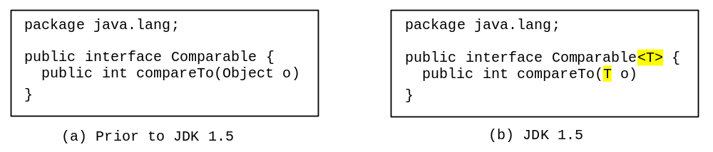
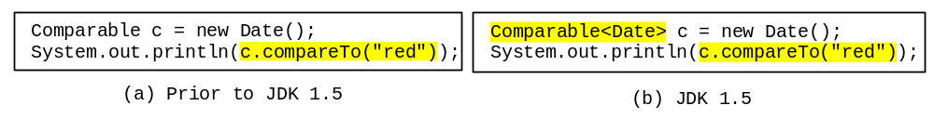
Generic Type
* Improves reliability
Generic Instantiation
Runtime error
Compile error

Slide 8
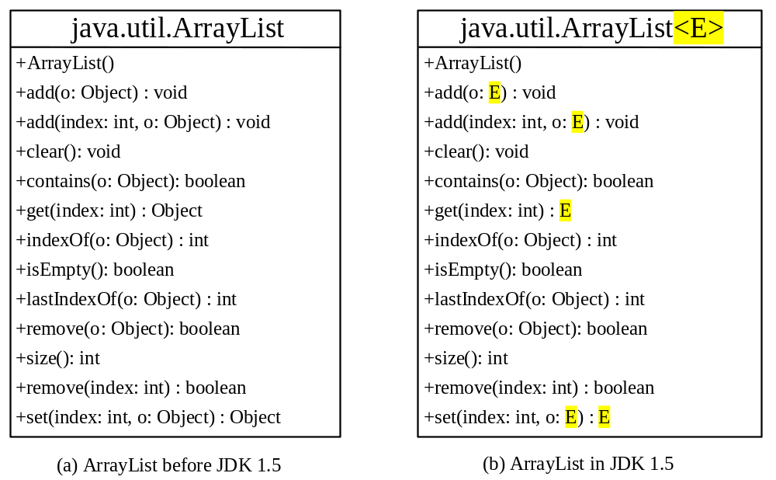
Generic ArrayList in JDK 1.5

Slide 9
No Casting Needed
ArrayList<Double> list = new ArrayList<Double>();
list.add(5.5); // 5.5 is auto converted to new Double(5.5)
list.add(3.0); // 3.0 is auto converted to new Double(3.0)
Double doubleObject = list.get(0); // No casting is needed
double d = list.get(1); // Automatically converted to double

Slide 10
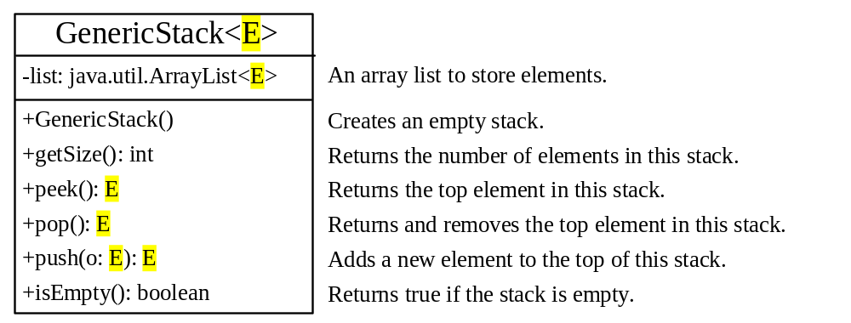
Declaring Generic Classes and Interfaces
GenericStack

Slide 11
Generic Methods
// Prior to JDK 1.5
public static void print(Object[] list) {
for (int i = 0; i < list.length; i++)
System.out.print(list[i] + " ");
System.out.println();
}
// Since after JDK 1.5
public static <E> void print(E[] list) {
for (int i = 0; i < list.length; i++)
System.out.print(list[i] + " ");
System.out.println();
}
To invoke a generic method, prefix the method name with the actual type in angle brackets. For example, if strings is an array of strings: ClassName.<String>print(strings);
or simply invoke it as: print(strings);

Slide 12
Bounded Generic Type
public static void main(String[] args ) {
Rectangle rectangle = new Rectangle(2, 2);
Circle9 circle = new Circle9(2);
System.out.println("Same area? " + equalArea(rectangle, circle));
}
public static <E extends GeometricObject> boolean
equalArea(E object1, E object2) {
return object1.getArea() == object2.getArea();
}

Slide 13
Raw Type and Backward Compatibility
// raw type
ArrayList list = new ArrayList();
This is roughly equivalent to:
ArrayList<Object> list = new ArrayList<Object>();

Slide 14
Raw Type is Unsafe
// Max.java: Find a maximum object
public class Max {
/** Return the maximum between two objects */
public static Comparable max(Comparable o1, Comparable o2) {
if (o1.compareTo(o2) > 0)
return o1;
else
return o2;
}
}
Runtime Error: Max.max("Welcome", 23);

Slide 15
Make it Safe
// Max1.java: Find a maximum object
public class Max1 {
/** Return the maximum between two objects */
public static <E extends Comparable<E>> E max(E o1, E o2) {
if (o1.compareTo(o2) > 0)
return o1;
else
return o2;
}
}
Compilation Error: Max1.max("Welcome", 23);

Slide 16
Wildcards
Why wildcards are necessary? See this example.
Demo 1 - WildCardNeed
? unbounded wildcard
? extends T bounded wildcard
? super T lower bound wildcard
Demo 2 – AnyWildCard
Demo 3 – SuperWildCard

Slide 17
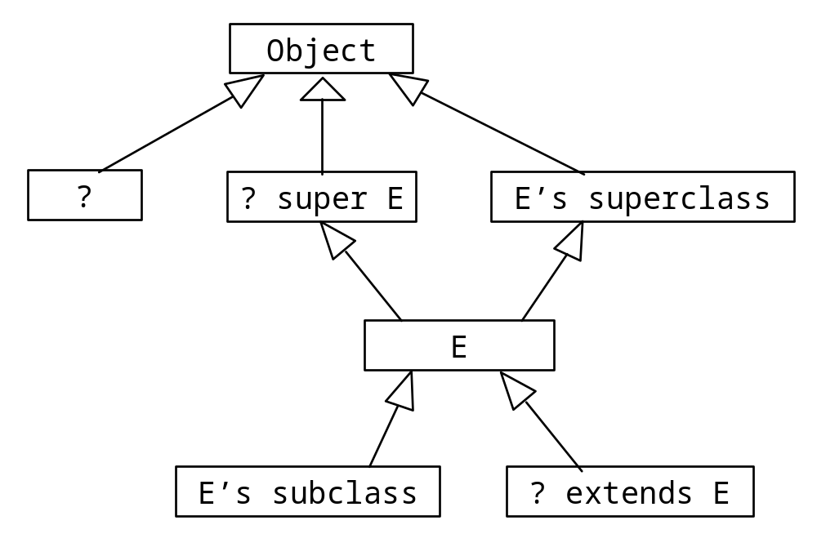
Generic Types and Wildcard Types

Slide 18
Avoiding Unsafe Raw Types
Use
    new ArrayList<ConcreteType>()
Instead of
    new ArrayList();
TestArrayListNew
Run

Slide 19
Erasure and Restrictions on Generics
Generics are implemented using an approach called type erasure. The compiler uses the generic type information to compile the code, but erases it afterwards. So the generic information is not available at run time. This approach enables the generic code to be backward-compatible with the legacy code that uses raw types.

Slide 20
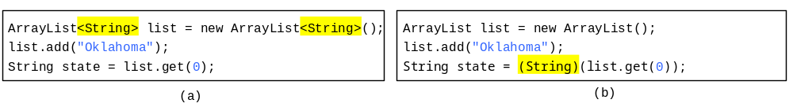
Compile Time Checking
For example, the compiler checks whether generics is used correctly for the following code in (a) and translates it into the equivalent code in (b) for runtime use. The code in (b) uses the raw type.

Slide 21
Important Facts
It is important to note that a generic class is shared by all its instances regardless of its actual generic type.
GenericStack<String> stack1 = new GenericStack<String> ();
GenericStack<Integer> stack2 = new GenericStack<Integer>();
Although GenericStack<String> and GenericStack<Integer> are two types, but there is only one class GenericStack loaded into the JVM.

Slide 22
Restrictions on Generics
Restriction 1: Cannot create an instance of a generic type. (i.e., new E()).
Restriction 2: Generic array creation is not allowed. (i.e., new E[100]).
Restriction 3: A generic type parameter of a class is not allowed in a static context.
Restriction 4: Exception classes cannot be generic.

Slide 23
Restriction 3:
A generic type parameter of a class is not allowed in a static context.
generic class parameter
E.g.
public class Test<E> {
public static void m(E o1) {
}
public static E o1;
static {
E o1;
}
}
Not allowed

Slide 24
Designing Generic Matrix Classes
Objective: This example gives a generic class for matrix arithmetic. This class implements matrix addition and multiplication common for all types of matrices.
GenericMatrix

Slide 25
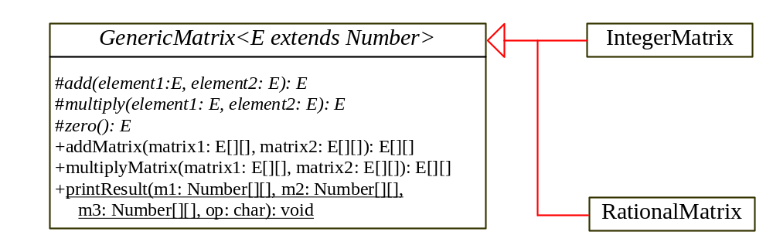
UML Diagram

Slide 26
Source Code
Objective: This example gives two programs that utilize the GenericMatrix class for integer matrix arithmetic and rational matrix arithmetic.
IntegerMatrix
TestIntegerMatrix
Run
Rational
RationalMatrix
TestRationalMatrix
Run

